Slide 1
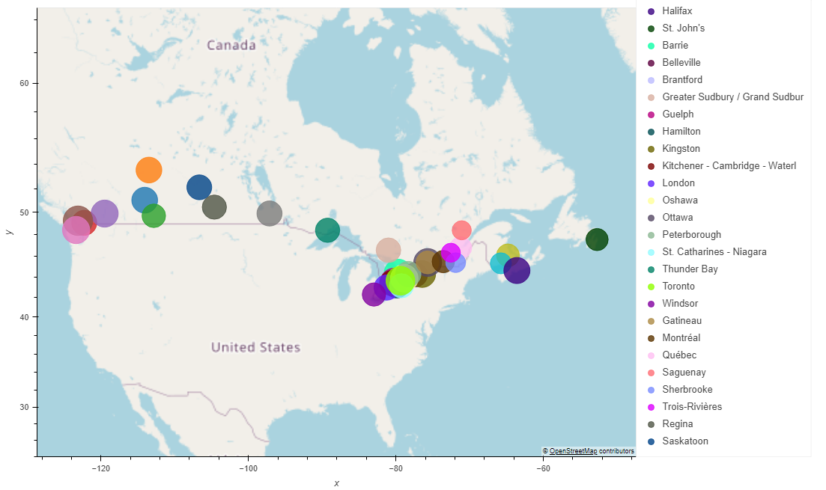
Rental Market Analysis: Canada
ABISOLA OLAKANMI | KERRY-ANN MORRISON-JAMES | LUCY JIAO | RIMPLE POONIA DABAS | SAKSHI DALAL | SWETA JOSHI

Slide 2
Main Objectives and questions to answer
Overview of Rental Market Trends from 2018 to 2022
What were the major trends in average rents, number of units, and vacancy rates during this period across Canada?
Y/Y percentage change in Average rent during this period?
Province wise
Ontario
British Columbia
Nova Scotia
Quebec
Saskatchewan
Alberta
Rental Market Analysis for the year 2022
How do average rents and vacancy rate vary across provinces in Canada?
How does the location impacts average rents between cities in Ontario and neighbourhoods in Toronto?
Is there any relation between average rents and vacancy rates between cities in Ontario and neighbourhoods in Toronto ?
To overlay our rental data location wise across Canada and Ontario using API and hvplots
Province major Cities
Ontario
Within City
GTA

Slide 3
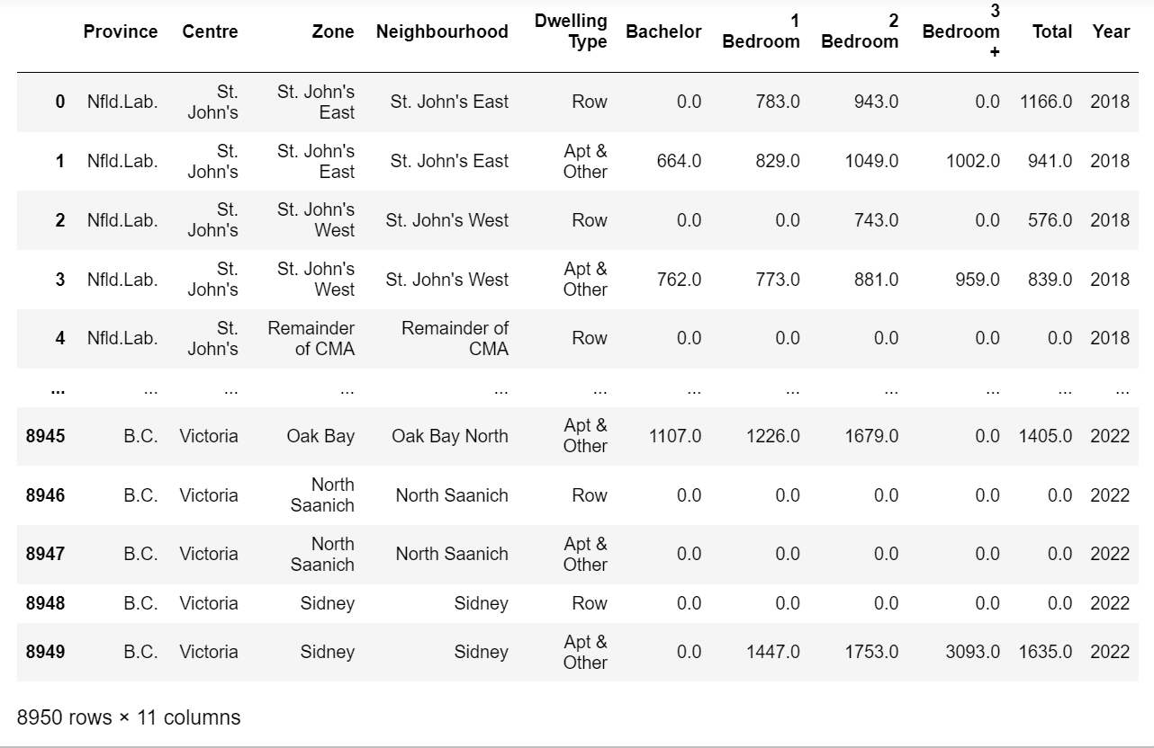
Data Sources : Canada Mortgage and Housing Corporation (CMHC)
Data is for urban centres with at least 10,000 people Organized by province and number of bedrooms. Drawn from CMHC’s Rental Market Survey
Average Rents
(2018-2022)
Vacancy Rates
(2018-2022)
Number of units
(2018-2022)

Slide 4
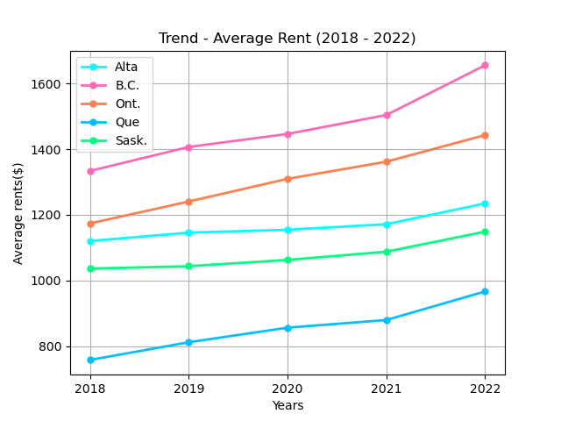
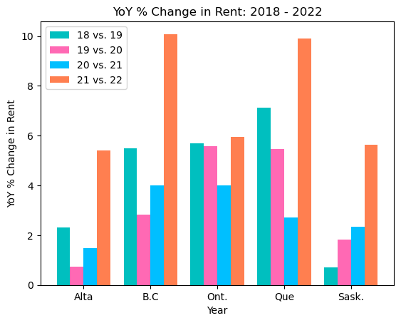
Province wise comparison (2018-2022)
Average Rents
Rental prices for all the five provinces shows increasing trend over the past five years
Y/Y % change shows the sharpest increase in all the provinces for year 21-22
Quebec stands out as having the highest Y/Y rent increases, with growth rates ranging from 5.5% to nearly 10% from 19-22
Saskatchewan has seen the smallest year-over-year rent increases among the provinces listed, with growth rates ranging from 1.8% to 5.6%.

Slide 5
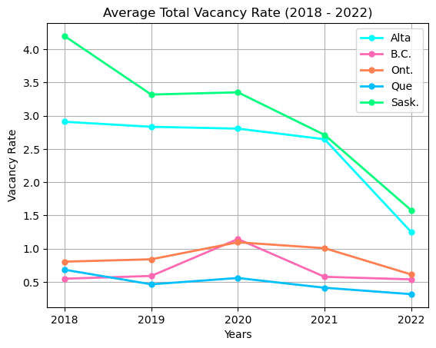
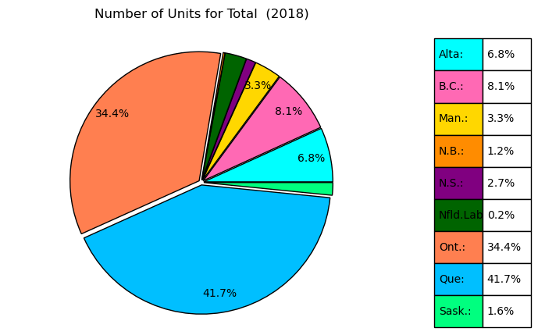
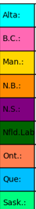

Province wise comparison (2018-2022) Vacancy Rate
Number of units
2018
The average vacancy rates for the top 5 provinces in Canada have fluctuated from 2018 to 2022, indicating some volatility in the rental market.
Ontario have generally maintained lower average vacancy rates compared to Alberta and British Columbia, with rates hovering around 1-2% between 2018 and 2022.
Number of units for dwelling types have been highest for Quebec through 2018 to 2022, Followed by Ontario which reflects the impact on vacancy rates as well.
2022

Slide 6
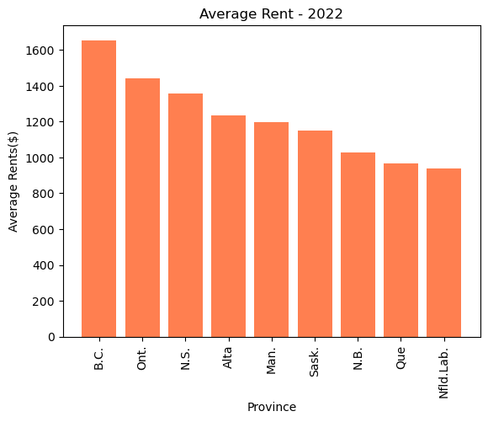
Average Rents across provinces 2022
Statistical Summary
British Columbia has the highest average rent of $1655 and Variance for all dwelling types for the year 2022 followed by Ontario
Quebec and New Foundland and Labrador has the lowest average rent for all dwelling types for the year 2022

Slide 7
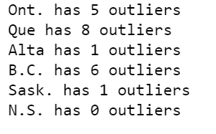
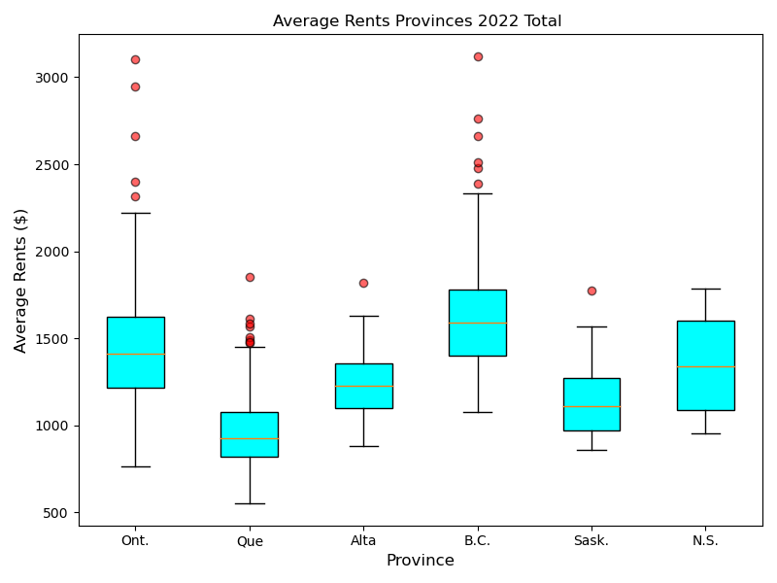
Inter quartile range ( IQR ) to quantitatively understand the distribution of data points determine if there are any potential outliers.
The datasets for Ontario and British Columbia are more dispersed as indicated by the summary statistics as well
IQR is maximum for Nova Scotia indicating the spread around the middle 50%.

Slide 8
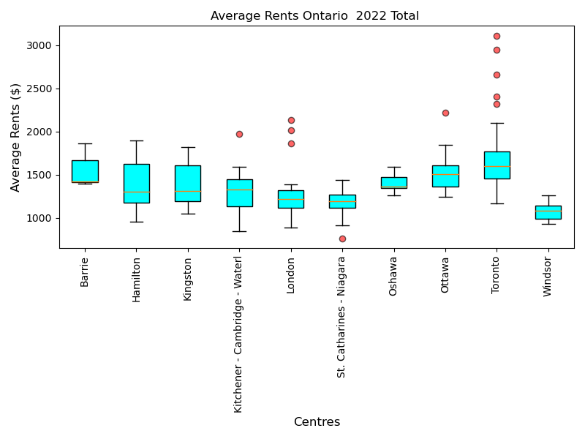
Average Rents across Ontario 2022
Statistical Summary
Within Ontario , Toronto have the highest average rents but it also have maximum number of outliers
The data for Barrie and Oshawa is highly skewed towards right indicating most of the data points le towards the lower end

Slide 9
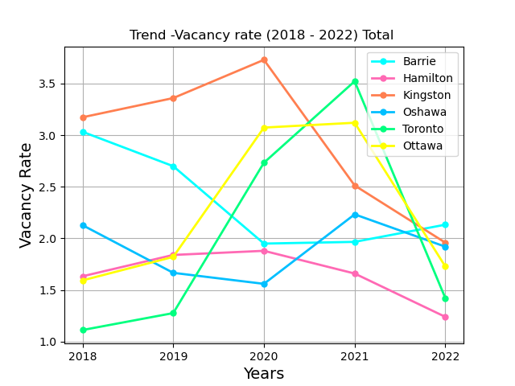
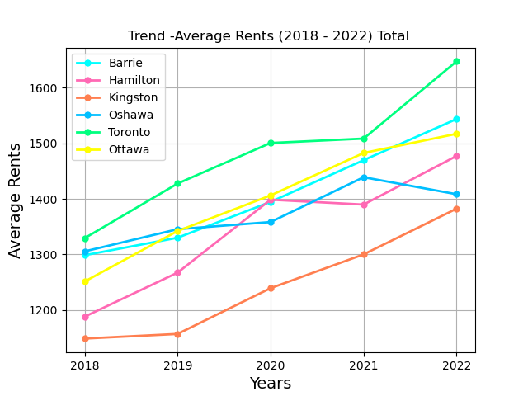
Vacancy Rate and Average Rents across Ontario (2018 – 2022)
Vacancy rates decreased and average rents increased for major cities in Ontario compared in the graphs except Oshawa for the year 2021-2022

Slide 10
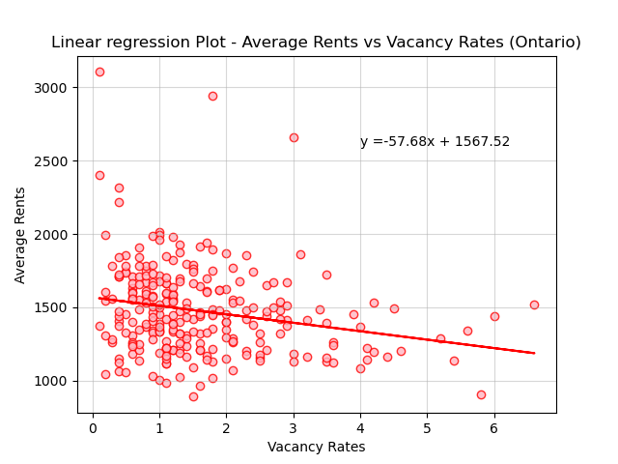
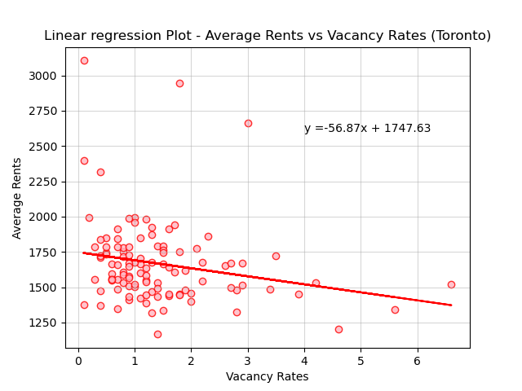
Relationship between Vacancy rates and Average rents
r- value is -0.22
r- value is -0.21
The result on the Vacancy Rates versus Average rents showed a weak negative correlation , and low R-squared value(-0.22) for Ontario cities
The result on the Vacancy Rates versus Average rents showed a weak negative correlation , and low R-squared value(-0.21) for Toronto Zones
This may be due to the outliers present in both datasets

Slide 11
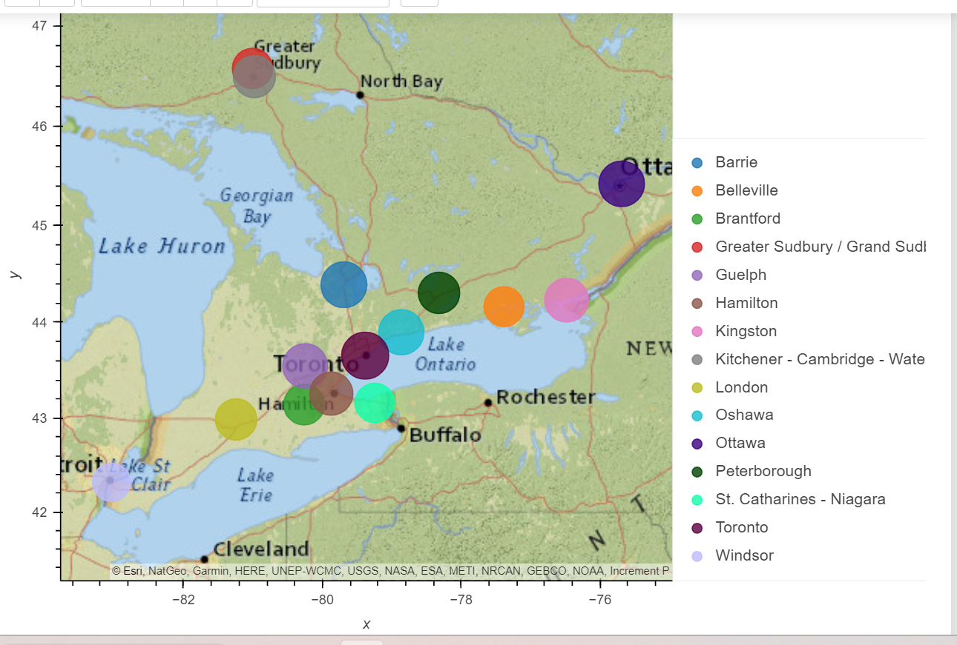
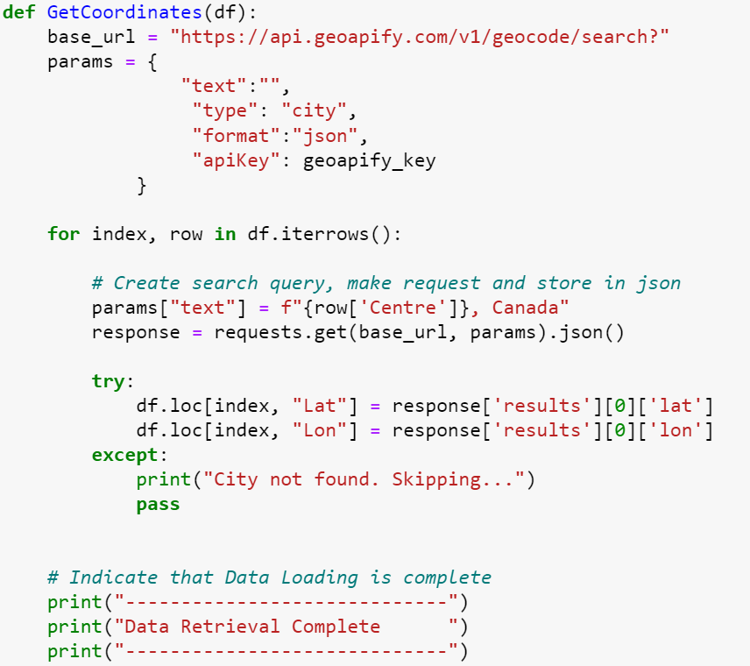
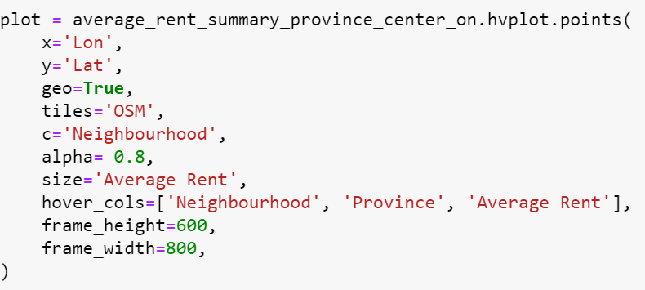
Map displaying point for the city with size of the point the average rental rates in the city
API Used :Geoapify

Slide 12
Observable Trends
In general, the y/y rent increases across these Canadian provinces have been relatively modest over the period from 2018 to 2022, with most provinces experiencing increases of less than 10% per year.
British Columbia and Ontario have experienced more moderate increases in rent over the same period, with growth rates ranging from 2.8% to 6% per year. Despite the moderate increase, these provinces continue to have some of the highest average rent prices in the country. The factors influencing this could be higher net Migration and Mortgage rates.
Within Ontario average rents have been consistently increasing with Toronto being at the highest over the period of 2018-2022 only exception being constant during 2020-2021. We are assuming this to be the effect of Covid pandemic.
Vacancy Rates and Average rents have mild negative correlation. We cannot conclude with certainty that increase in one of them has significant impact on another. For better visualization we need to remove the outliers from our datasets.
Contributors
Data research – Rimple
Data Cleaning – Sweta ,Kerry ,Rimple
Data merging – Rimple
Data Visualization – Sweta, Sakshi, Lucy, Abisola, Kerry, Rimple
Data Analysis - Sweta, Sakshi, Lucy, Abisola, Kerry, Rimple
API – Sweta
Presentation - Rimple

Slide 13
Thank You! Any Questions

Slide 14
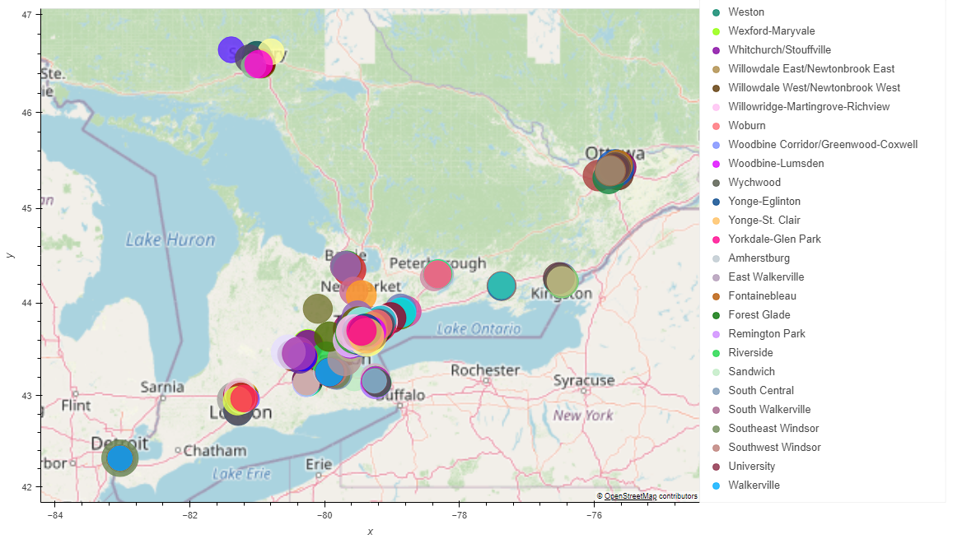

Slide 15
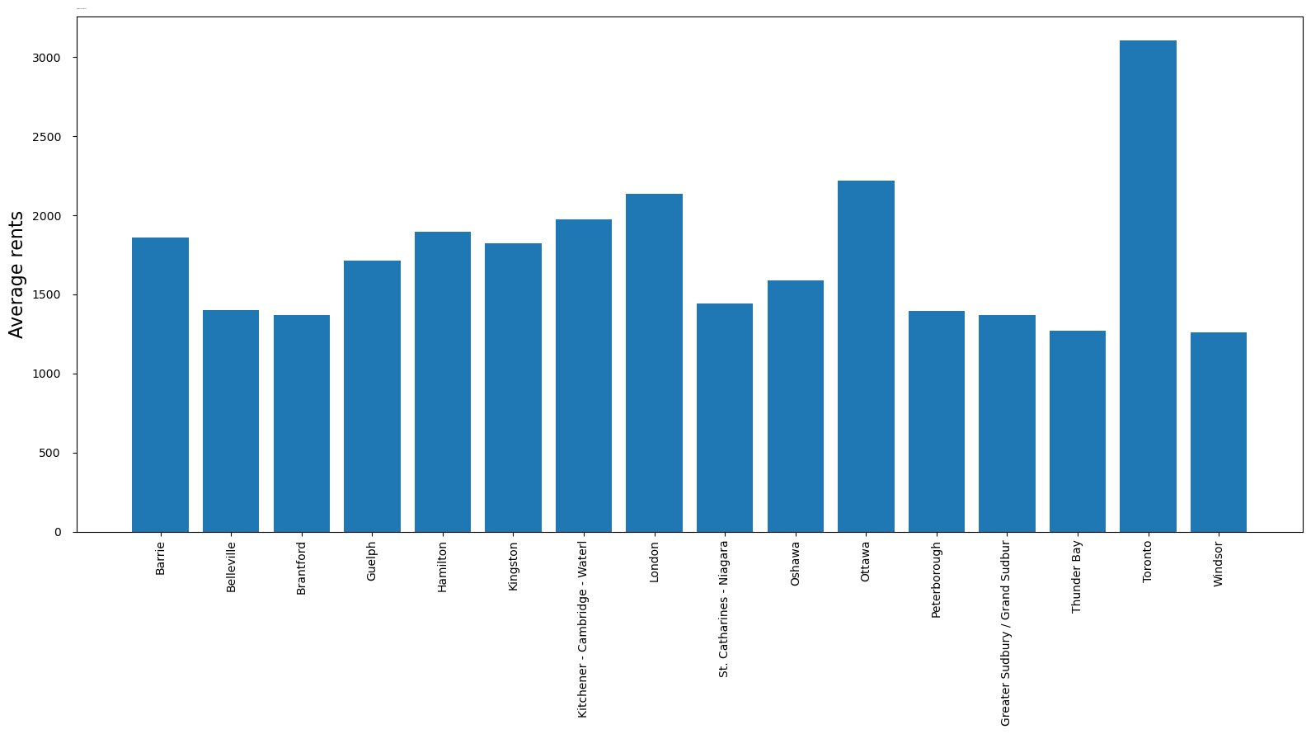

Slide 16
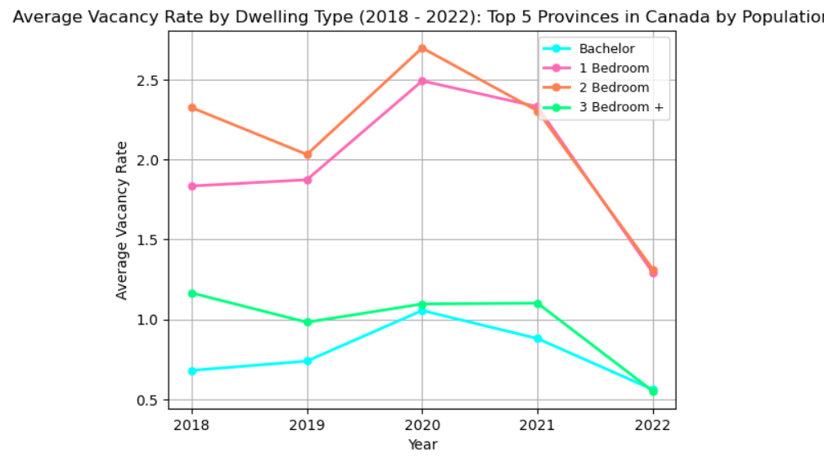
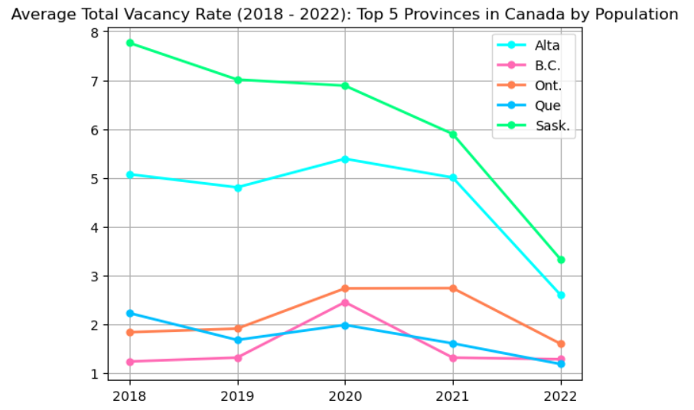

Slide 17
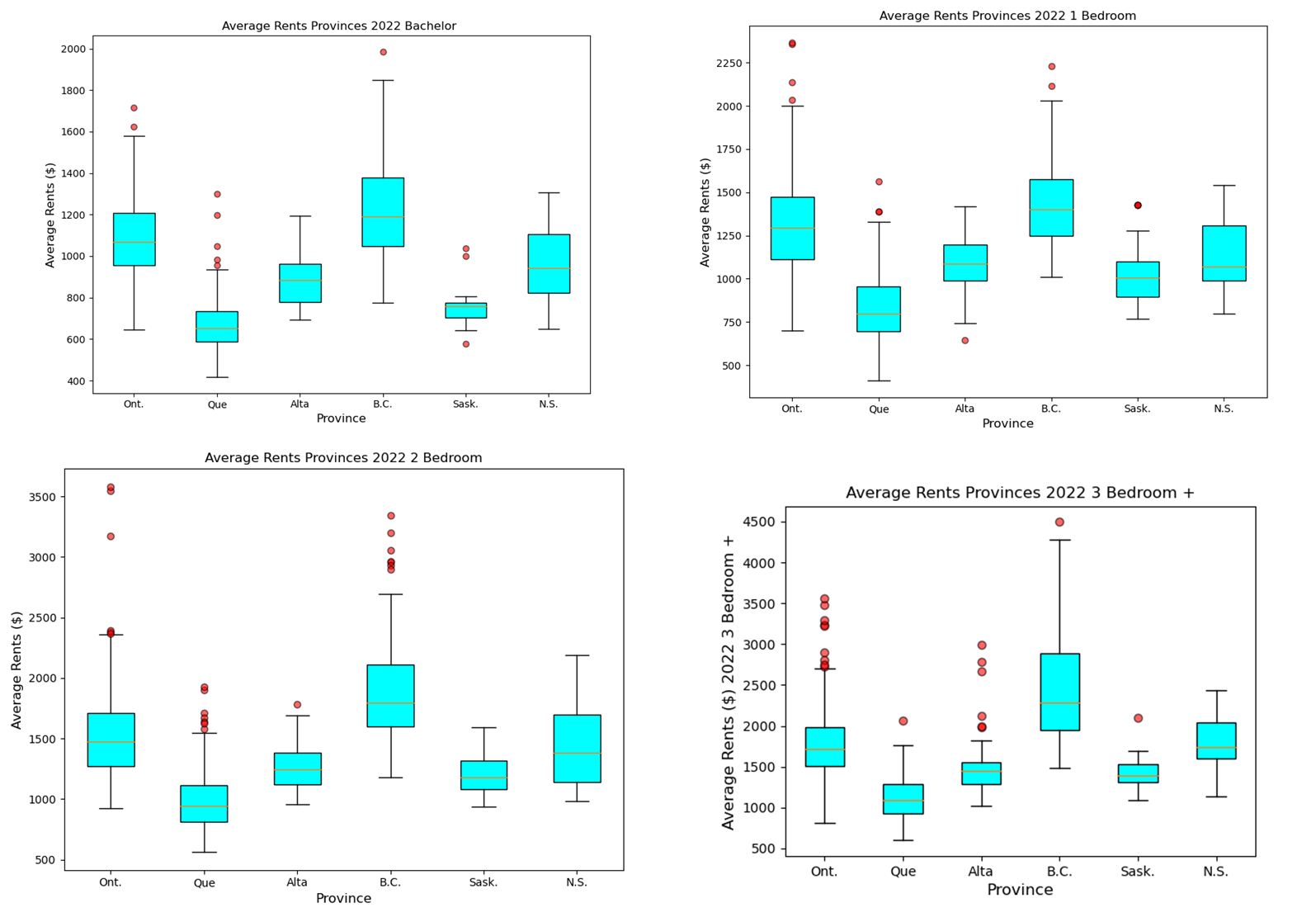

Slide 18
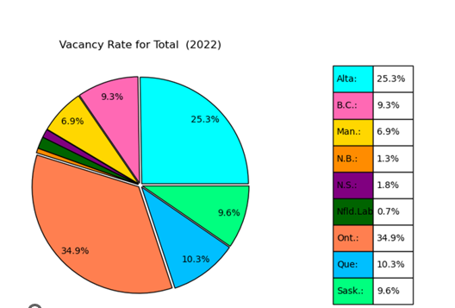
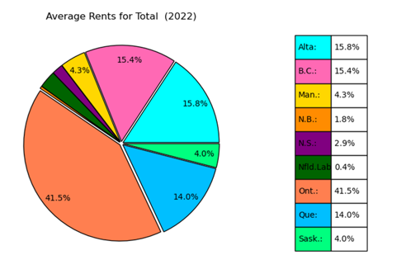

Slide 19
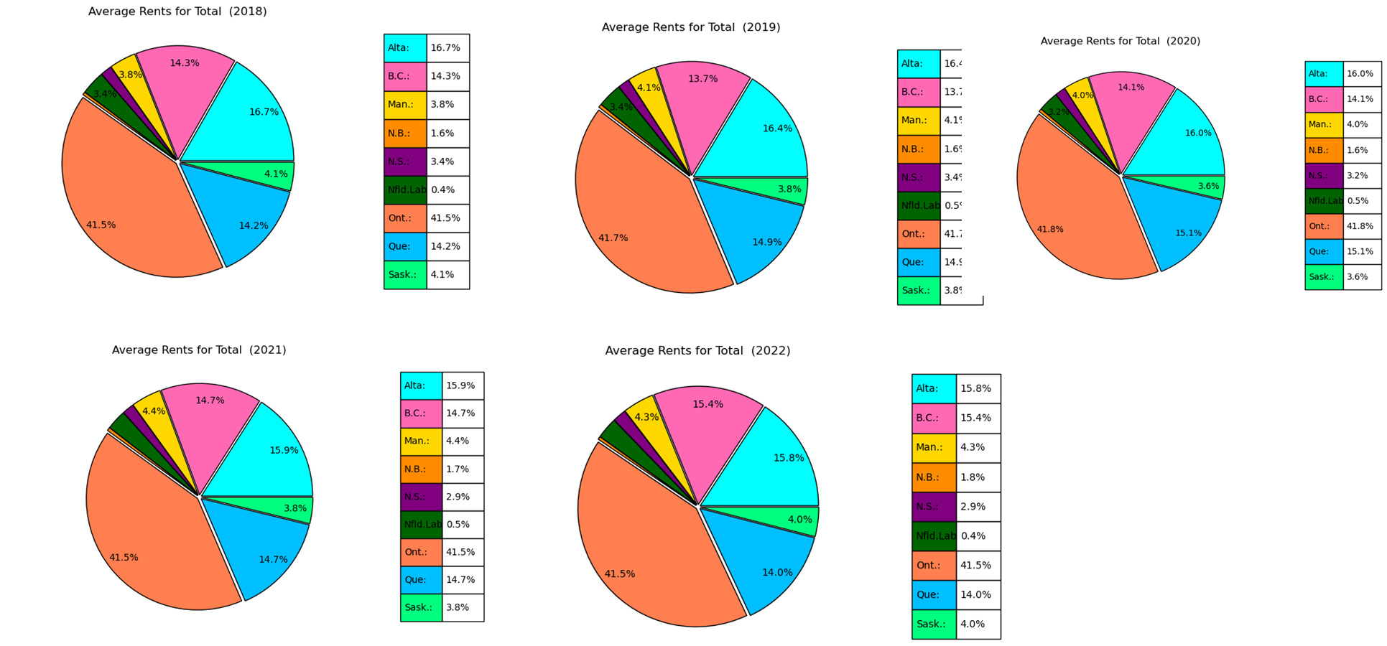

Slide 20
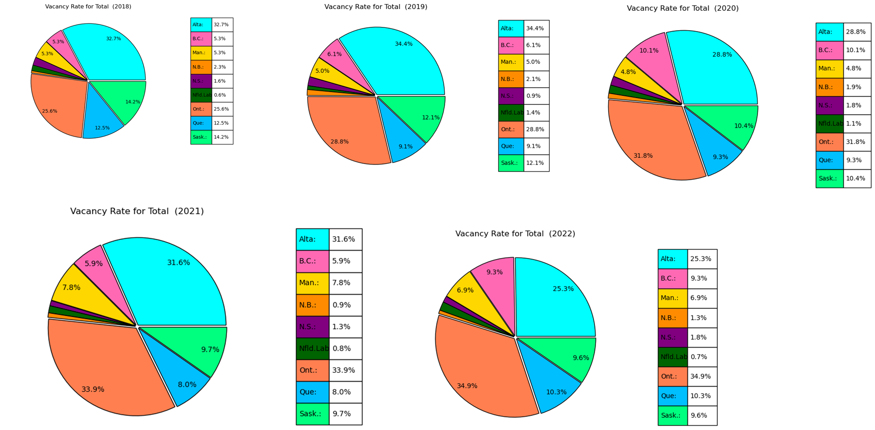

Slide 21




Slide 22
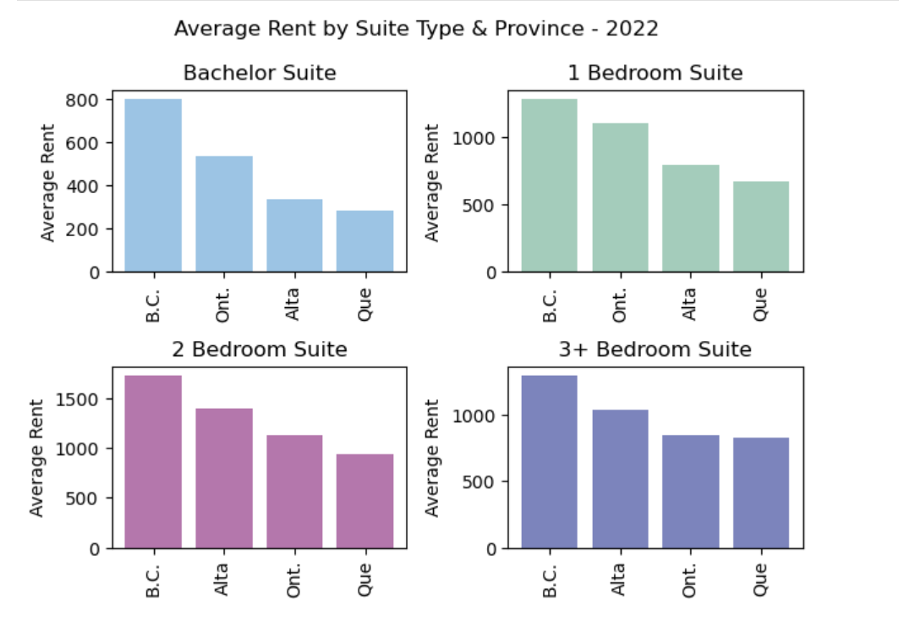

Slide 23
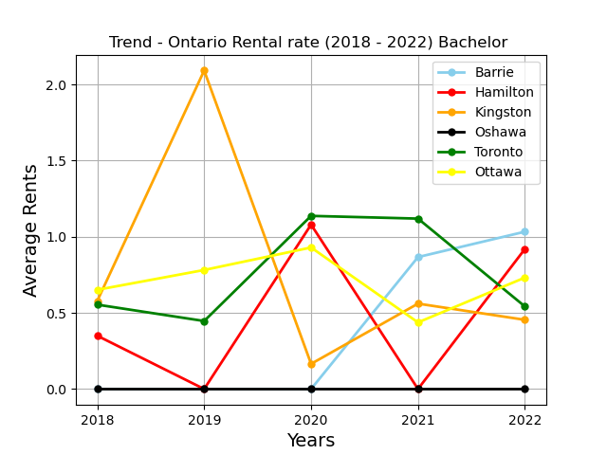
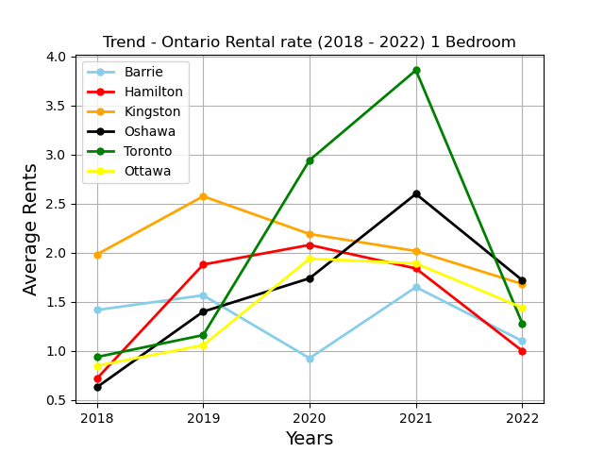
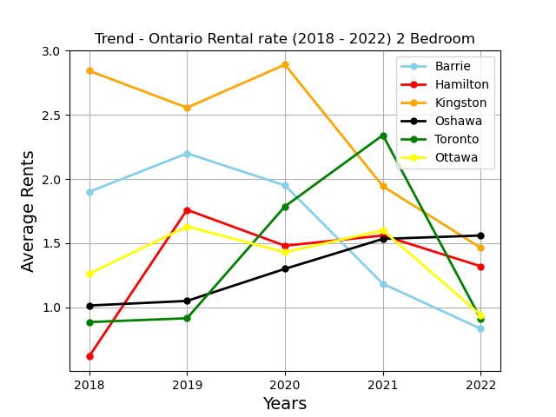

Slide 24
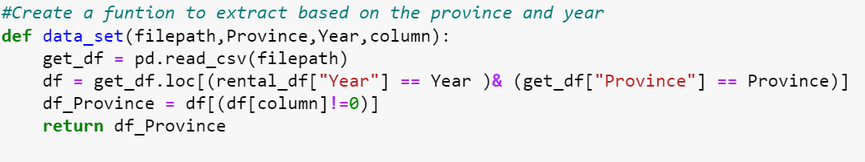
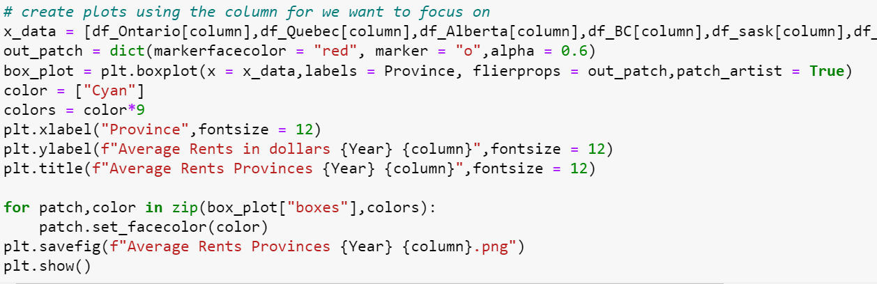
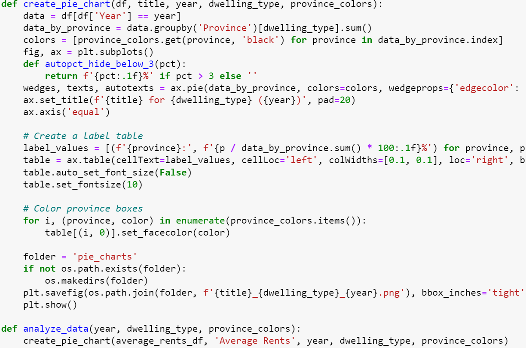

Slide 25
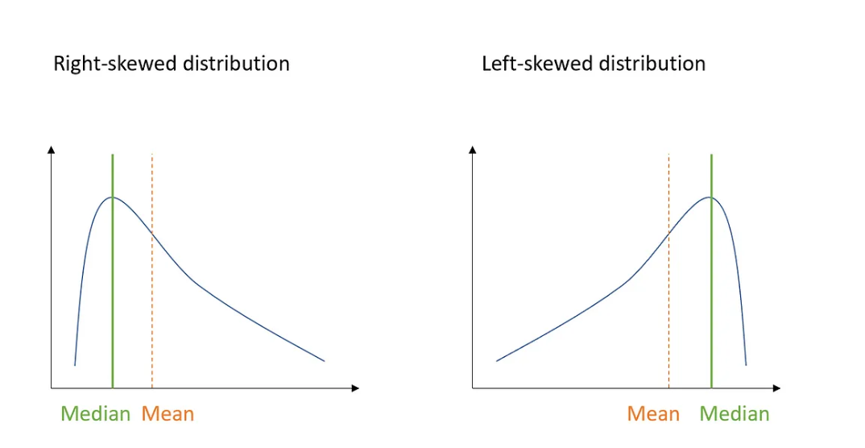
Basically, whenever the median is closer to the lower bound of the box, and the upper whisker is longer than the lower one, it indicates that the distribution is right-skewed (the skewness is positive).
On the other hand, whenever the median is closer to the upper bound of the box, and the lower whisker is longer than the upper one, it indicates a left-skewed distribution (the skewness is negative)

